Slide 1
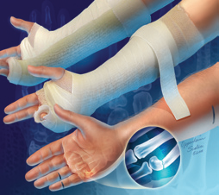
Plaster in Orthopaedics

Slide 2
Principles of Casting and Splinting
The ability to properly apply casts and splints is a technical skill easily mastered with practice and an understanding of basic principles
The initial approach to casting and splinting requires a thorough assessment of the skin, neurovascular status, soft tissues, and bony structures to accurately assess and diagnose the injury
Once the need for immobilization has been determined, the physician must decide whether to apply a splint or a cast

Slide 3
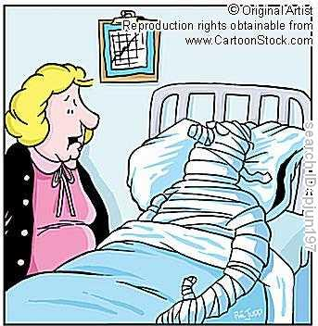
You’re looking well !!

Slide 4
Immobilization techniques
Casts and splints serve to immobilize orthopedic injuries
  They promote healing,
  Maintain bone alignment,
  Diminish pain,
  Protect the injury, and
  Help compensate for surrounding muscular weakness
Improper or prolonged application can increase the risk of complications from immobilization

Slide 5
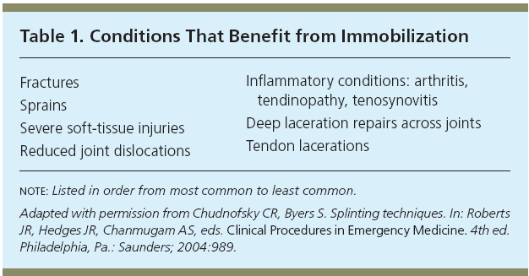
Indications

Slide 6
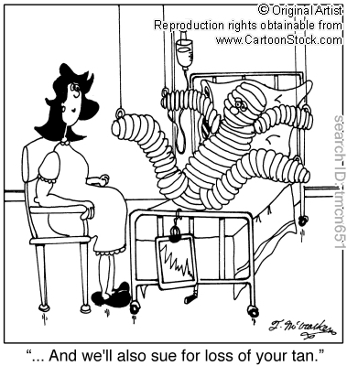
'... And we'll also sue for loss of your tan.'

Slide 7
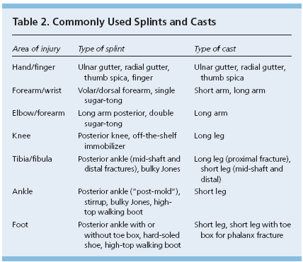

Slide 8
Splinting Versus Casting
When considering whether to apply a splint or a cast, the physician must assess
  The stage and severity of the injury,
  The potential for instability,
  The risk of complications, and
  The patient’s functional requirements
Splinting is more widely used in primary care for acute as well as definitive management (management following the acute phase of an injury) of orthopedic injuries
  Splints are often used for simple or stable fractures, sprains, tendon injuries, reduced joint dislocations, sprains, severe soft tissue injuries, and post-laceration repairs
Casting is usually reserved for definitive and/or complex fracture management

Slide 9
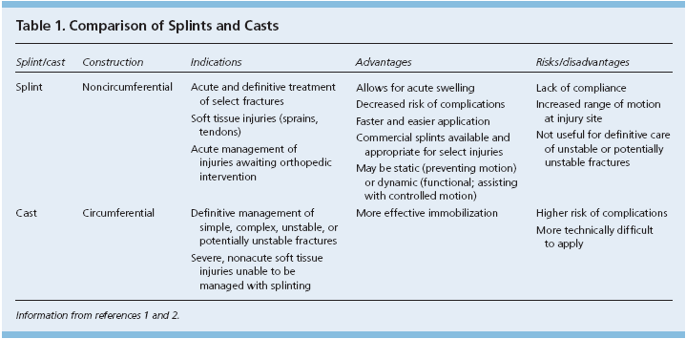
Splinting Versus Casting

Slide 10
Clinical Recommendation
Splinting is the preferred method of fracture immobilization in the acute care setting.
Casting is the mainstay of treatment for most fractures.
Plaster should be used for most routine splinting applications.
  However, when weight or bulk of the cast or the time to bearing weight is important, a synthetic material chosen principally on the basis of cost is indicated.

Slide 11
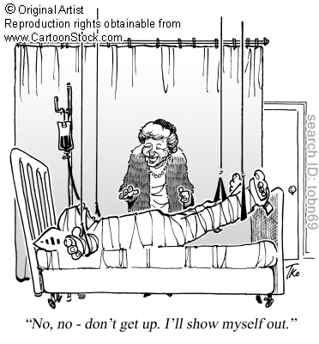
'No, no - don't get up. I'll show myself out.'

Slide 12

Advantages of Splinting
Splint use offers many advantages over casting
  Splints are faster and easier to apply.
  May be static (i.e., prevent motion) or dynamic (i.e., functional; assist with controlled motion).
  Splints being non-circumferential, allow for the natural swelling that occurs during the initial inflammatory phase of the injury
  Pressure related complications increase with severe soft-tissue swelling, particularly in a contained space such as a circumferential cast
  Therefore, splinting is the preferred method of immobilization in the acute care setting
  Furthermore, a splint may be removed more easily than a cast, allowing for regular inspection of the injury site.
    Both custom-made and standard “offthe- shelf” splints are effective

Slide 13

Disadvantages of splinting
Disadvantages of splinting include
  Lack of patient compliance and excessive motion at the injury site.
  Splints also have limitations in their usage.
  Fractures that are unstable or potentially unstable (e.g., fractures requiring reduction, segmental or spiral fractures, dislocation fractures) may be splinted acutely to allow for swelling or to provide stability while awaiting definitive care.
  However, splints themselves are inappropriate for definitive care of these types of injuries.
  Such fractures are likely to require casting and orthopedic referral

Slide 14


Advantages and Disadvantages of Casting
Casting is the mainstay of treatment for most fractures
Casts generally provide more effective immobilization, but,
  Require more skill and time to apply, and,
  Have a higher risk of complications if not applied properly

Slide 15
Materials and Equipment
Plaster has traditionally been the preferred material for splints
  Plaster is more pliable and has a slower setting time than fiberglass, allowing more time to apply and mold the material before it sets.
  Materials with slower setting times also produce less heat, thus reducing patient discomfort and the risk of burns.
Fiberglass is a reasonable alternative because the cost has declined since it was first introduced
  It produces less mess, and it is lighter than plaster
  Fiberglass is commonly used for nondisplaced fractures and severe soft-tissue injuries.
Previous literature has demonstrated the benefits of using plaster rather than fiberglass following fracture reduction

Slide 16
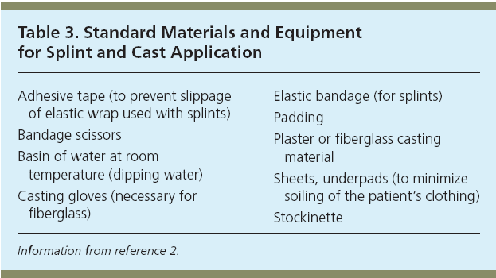

Slide 17
Plaster of Paris
Plaster of Paris is a hemi hydrated calcium phosphate.
  To make plaster of paris, gypsum is heated to drive off water.
  When water is added to the resulting powder original mineral forms and is set hard.
2(Caso₄ 2H₂O) +Heat 2(Caso₄ 1/2 H₂O) + 3H₂O

Slide 18
Historical background POP
The name Plaster of paris originated from an accident to a house built on deposit of gypsum near the city of paris
  The house was accidentally burnt down.
  When it rained on the next day, it was noted that the foot prints of the people in the mud had set rock hard.
Plaster of paris was first used in orthopedics by Mathysen, a Dutch surgeon, in 1852
It is made from gypsum which is a naturally occurring mineral
It is commercially available since 1931.

Slide 19
Types of POP
Indigenous
  Prepared from ordinary cotton bandage role smeared with POP powder.
Commercial
  Plaster of paris rolls commercially prepared consists of rolls of muslin stiffened by starch POP powder and an accelerator substance like alum.
  This commercial preparation sets very fast and gives a neat finish unlike the indigenous ones.

Slide 20
Plaster
Plaster bandages and splints are made by impregnating crinoline with plaster of paris [CaSO₄)₂H₂O].
  When this material is dipped into water, the powdery plaster of paris is transformed into a solid crystalline form of gypsum.
The amount of heat given off is determined by the amount of plaster applied and the temperature of the water.
The more plaster and the hotter the water, the more heat is generated.
The interlocking of the crystals formed is essential to the strength and rigidity of the cast.

Slide 21
Motion during the critical setting period interferes with this interlocking process and reduces the ultimate strength by as much as 77%.
The interlocking of crystals (the critical setting period) begins when the plaster reaches the thick creamy stage, becomes a little rubbery, and starts losing its wet, shiny appearance.
Cast drying occurs by the evaporation of the water not required for crystallization.
The evaporation from the cast surface is influenced by air temperature, humidity, and circulation about the cast.
Thick casts take longer to dry than thin ones.
Strength increases as drying occurs.

Slide 22
Plaster is available as bandage rolls in widths of 8, 6, 3, and 2 inches and splints in 5- Ã— 45-inch, 5- Ã— 30-inch, and 3- Ã— 15-inch sizes.
Additives are used to alter the setting time.
Three variations are available.
  Extra-fast setting takes 2 to 4 minutes,
  Fast setting takes 5 to 6 minutes, and
  Slow setting takes 10 to 18 minutes.

Slide 23
Advantages Plaster of Paris
It is cheap
It is easily available
It is comfortable
It is easy to mould
It is strong and light
It is easy to remove
It is permeable to radiography
It is permeable to air and hence underlying skin can breathe.
It is non inflammable

Slide 24
Various forms of POP
Plaster of Paris is used in four forms as
  Slab,
  Cast,
  Spica and
  Functional cast brace

Slide 25
Slab
It is a temporary splint used in the initial stages of fracture treatment and also during first aid, it is useful to immobilize the limbs postoperatively and in infections.
It is made up of half by POP and half by bandage roll hence can accommodate the swelling in the initial stages of fractures.
Is prepared according to the required length.

Slide 26
Slab
There are three methods of applying slab.
  Dry method:
    Here the slab is prepared first and then dipped in water (commonly employed)
  Wet method:
    Here the slab is prepared after dipping the POP roll in water. This is rare and requires experience.
  Pattern Method:
    Here the slabs are fashioned in the desired way before dipping in water.

Slide 27
Cast
Here the POP completely encircles the limb.
  It is used as a definitive form of fracture treatment and also to correct deformities.
There are three methods of applying a POP cast.
  Skin tight cast:
    Here the cast is directly applied over the skin. Dangerous as it may cause pressure sores. It is difficult to remove as the hairs may be incorporated into the cast and hence it is not recommended.
  Bologna cast:
    How generous amount of cotton padding is applied to the limb before putting the cast. This is the commonly employed method.
  Three tier cast:
    Here stockinette is used first, over which cotton padding is done before applying the POP cast. It is an ideal method, but it is expensive.

Slide 28
Spica
Spica encircles a part of the body,
  e.g., hip spica for fracture around the hip,
  thumb spica for fracture scaphoid

Slide 29
Functional cast brace
Functional cast brace is used for fracture tibia after initial immobilization of 3 to 4 weeks.

Slide 30
Fiberglass cast
In recent years, a number of companies have developed materials to replace plaster of paris as a cast.
Most of these are a fiberglass fabric impregnated with polyurethane resin.
The prepolymer is methylene bisphenyl diisolynate, which converts to a nontoxic polymeric urea substitute.
The exothermic reaction does not place the patient's skin at risk for thermal injury
These materials are preferred for most orthopaedic applications except in acute fractures in which reduction maintenance is critical
Fiberglass casts do not provide higher skin pressure when compared to plaster casts when properly applied .

Slide 31
Important issues relating to a plaster
Factors influencing plastering
  Preparation of the patients.
  Plaster application principles.
  Care of the cast.
  Instructions to patients.
  Complications.
  Removal of plaster casts.

Slide 32
Advantages and Disadvantages of fiberglass cast
Advantages
  These materials are strong, lightweight, and resist breakdown in water; they are also available in multiple colors and patterns
Disadvantages.
  They are harder to contour than plaster of paris
  The polyurethane may irritate the skin
  Fiberglass is harder to apply, although the newer bias stretch material is an improvement.
  Patients are commonly under the impression that fiberglass casts can be gotten wet. This is incorrect; if submerged, they need to be changed to avoid significant skin maceration.

Slide 33
Factors influencing plastering
Temperature
Strength
Padding
Incorporation
Absorption
Time
Notes:
Temperature
If a bandage is immersed in cold water the initial set will be delayed and thus working time lengthened.
However, if a very rapid set is required, soaking the bandage in warm water will accelerate the rate of reaction.
However, over 50°c, the setting rate slows and at 100°c no set occurs.
Strength
The final strength of the cast depends on the crystal structure.
If the cast is manipulated after the initial set or prevented from drying out it will be weak.
Drying out will be delayed in cold or moist conditions and accelerated in a warm and dry environment.
Obviously, the cast strength is dependent upon the quality and thickness of plaster and the shape of the cast which follows the contours of the affected limb.
However, excess plaster will also increase weight and bulk and heat released.
Therefore these different factors must be weighed against each other.
Padding
Padding is used under a plaster cast to mechanically protect the skin, soft tissue and bony abrasion during cast removal
Padding is necessary to protect the skin from thermal injury because of the exotherm generated during setting.
Poorly applied padding may reproduce sores.
Over padding will reduce the closeness of the fit of the cast and possibly permit excess movement at the fracture site resulting in impaired healing.
Thus, skill in padding is as essential as plaster moulding in production of a therapeutic cast.
Incorporation
Because plaster of paris is infinitely mouldable in the wet state, it can be set around cast brace, hinges and walking heels with ease, however, for maximum strength the plaster should dry out first and the walking attachment should be affixed with a fresh plaster of bandage.
Absorption
Too much exudates from inside or moisture from outside the cast will reduce the strength of the cast and make it liable to break down.
Time
The strength of plaster of paris builds up over a period of time and so load may be gradually increased.
Excessive premature loading will produce a breakdown of the cast and patients need to be advised how much load they can apply and at what time.

Slide 34
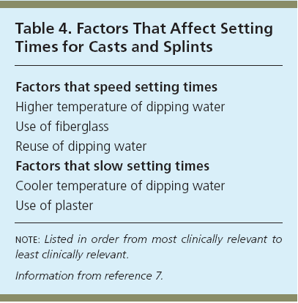
Factors influencing plastering

Slide 35
Application-Cast
Casting and splinting both begin by placing the injured extremity in its position of function.
  Casting continues with application of stockinette, then circumferential application of two or three layers of cotton padding, and finally circumferential application of plaster or fiberglass.
  In general, 2-inch padding is used for the hands, 2- to 4-inch padding for the upper extremities, 3-inch padding for the feet, and 4- to 6-inch padding for the lower extremities.

Slide 36
Splint
Splinting may be accomplished in a variety of ways.
  One option is to begin as if creating a cast and, with the extremity in its position of function, apply stockinette, then a layer of overlapping circumferential cotton padding.
  The wet splint is then placed over the padding and molded to the contours of the extremity, and the stockinette and padding are folded back to create a smooth edge
  The dried splint is secured in place by wrapping an elastic bandage in a distal to proximal direction.
  For an average-size adult, upper extremities should be splinted with six to 10 sheets of casting material, whereas lower extremities may require 12 to 15 sheets.

Slide 37
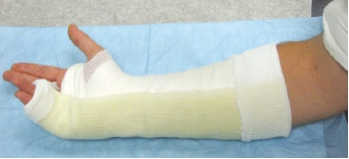
Ulnar gutter splint with underlying stockinette and circumferential padding.

Slide 38
Splint
An acceptable alternative is
  To create a splint without the use of stockinette or circumferential padding.
  Several layers of padding that are slightly wider and longer than the splint are applied directly to the smoothed, wet splint.
  Together they are molded to the extremity and secured with an elastic bandage
  Prepackaged splints consisting of fiberglass and padding wrapped in a mesh layer also exist.
    These are easily cut and molded to the injured extremity; however, they are more expensive and are not always available.
  Prefabricated and over the counter splints are the simplest option, although they are less “custom fit,” and their use may be limited by cost or availability.

Slide 39
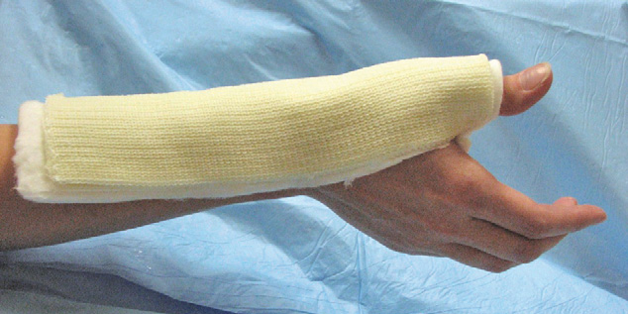
Padded thumb spica splint

Slide 40
Rules of application of pop casts
Choose the correct size
A joint above and a joint below should ideally be included.
  This is done to eliminate movements of the joints on either side of the fractures.
It should be moulded with the palm and not with the fingers for the fear of indentation.
The joints should be immobilized in functional position.
The plaster should be snugly fit and should not be too tight or too loose.
Uniform thickness of the plaster is preferred.
Notes:
Choose the correct size, 8 inches for the thigh 6 inches for the leg 4 inches for the forearm.
A joint above and a joint below should be included.
Accordingly we have an above elbow or below elbow POP cast or slab and above knee or below knee POP cast or slab. This is done to eliminate movements of the joints on either side of the fractures. However this is not a hard and fast rule in certain fractures like a below elbow cast in colles fracture which often suffices.
It should be moulded with the palm and not with the fingers for the fear of indentation.
The joints should be immobilized in functional position.
The plaster should be snugly fit and should not be too tight or too loose.
Uniform thickness of the plaster is preferred.

Slide 41
Common casting errors
The most common casting errors are:
  Poor choice of cast type: failure to immobilize a joint above and below injury
  Redundancy and bunching in cast liner or padding secondary to careless, uneven application or extremity repositioning after application with resultant “pressure point” formation and skin breakdown (antecubital fossa)
  Excessively tight padding or cast material application
  Inadequate padding at pressure points (olecranon and ulnar border)
  Failure to extend cast to appropriate proximal and distal levels
  Poor molding technique with subsequent cast displacement or loss of reduction
  Acceptance of a suboptimal cast

Slide 42
Stages of plaster application
First Stage
  The first stage involves the application of POP slab or cast.
Second stage or cast –setting stage
  Change of pop to gypsum
  Defined as the time taken to form rigid dressing after contact with water.
Third stage or Green stage
  The just set wet cast.
Fourth Stage or cast Drying
  By evaporation of excess of water when the cast dries.
  This results in a mature cast with multiple air pockets through which the skin breathes.

Slide 43
General Application Procedures
Preparing the Injured Area
  Stockinette is measured and applied to cover the area and extend about 10 cm beyond each end of the intended splint site
  Excess stockinette is folded back over the edges of the splint to form a smooth, padded edge.
  Stockinette should not be too tight
  Wrinkling over flexion points and bony prominences should be minimized by smoothing or trimming the stockinette.
  Generally, 2 to 3 inches wide stockinette is used for the upper extremities and 4 inches wide for the lower extremities.

Slide 44
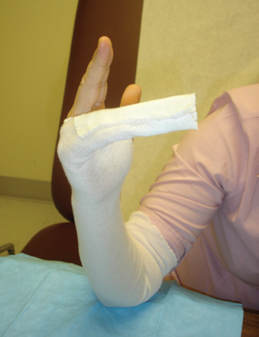
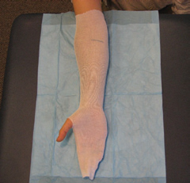
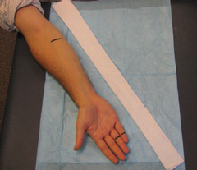

Slide 45
Once a physician is proficient in splinting, a splint can be created without the use of a stockinette.
  This technique may be particularly useful if dramatic swelling is anticipated and care is being taken to avoid using any circumferential materials that are not essential.
  Padding that is slightly wider and longer than the splinting material should be applied in several layers directly to the smoothed, wet splint.
Together, the padding and splinting material are molded to the extremity.

Slide 46
Next, layers of padding are placed over the stockinette
  To prevent maceration of the underlying skin and to accommodate for swelling.
Padding is wrapped circumferentially around the extremity, rolling the material from one end of the extremity to the other, each new layer overlapping the previous layer by 50 percent.
  This technique will automatically provide two layers of padding.
  Extra layers may be added over the initial layers, if necessary.
  The padding should be at least two to three layers thick without being constrictive, and should extend 2 to 3 cm beyond the intended edges of the splint

Slide 47
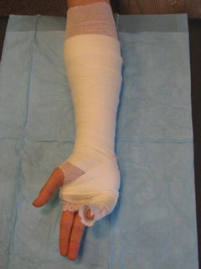

Slide 48
Extra padding is placed at each end of the intended splint border, between digits, and over areas of bony prominence.
Prominences at highest risk are the
  Ulnar styloid,
  Heel,
  Olecranon, and
  Malleoli.
If significant swelling is anticipated, more padding may be used
  Care must be taken not to compromise the support provided by the splint by using too many layers.
  Both too much and too little padding are associated with potential complications and poor fit of the splint or cast

Slide 49
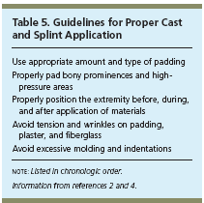

Slide 50
Joints should be placed in their proper position of function before, during, and after padding is applied to avoid areas of excess wrinkling and subsequent pressure.
In general,
  The wrist is placed in slight extension and ulnar deviation, and,
  The ankle is placed at 90 degrees of flexion.
Padding comes in several widths
  In general, padding 2 inches wide is used for the hands,
  2 to 4 inches for upper extremities,
  3 inches for feet, and,
  4 to 6 inches for lower extremities.

Slide 51
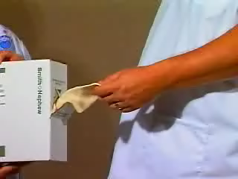

Slide 52
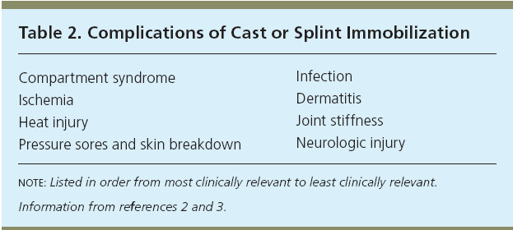
Complications of Immobilization
These conditions can occur regardless of how long the device is used
  To maximize benefits while minimizing complications, the use of casts and splints is generally limited to the short term.

Slide 53
Local Complications
Encasement of the limb or trunk in plaster may produce
  Pain
  Pressure sores
  Stiff joints,
  Muscle wasting and
  Impaired circulation
  Peripheral nerve injury
Physiotherapy and good nursing can help reduce these complications and speed the final recovery
Due to plaster allergy
  Allergic dermatitis.

Slide 54
Systemic Complications
The most serious is deep venous thrombosis leading to pulmonary embolism.
  Pain in the calf is an important sign needing medical advice.
Immobilization in trunk plasters or plaster beds may also produce
  Nausea, abdominal cramps, retension care of urine and abdominal distension.
Good nursing, and diet with regular exercises will help ensure that the initial period of extensive immobilization is achieved without complications.

Slide 55
References
Boyd A S et al. Splints and Casts: Indications and Methods. Am Fam Physician. 2009;80(5):491-499.
Boyd A S et al. Principles of Casting and Splinting. Am Fam Physician. 2009;79(1):16-22, 23-24
Cast-and-Bandaging-Techniques. Available at http://hubpages.com/hub/Cast-and-Bandaging-Techniques Assessed on 24.09.10

